Slide 1

PlaatProtect (Burglar / Fire Alarm Centre) Open Source Project
W.B.J. van der Plaat
(Software Architect)

Slide 2

PlaatProtect - Features
Burglar / Fire Alarm Centre on Raspberry Pi
Integrate Webcams
Motion detection with auto recording
Integrate Zigbee meshwork
Control lights in my house (Philips Hue)
Fire detector (Google Nest Protect)
Push alarm notifications to Mobile
Integrate Z-Wave meshwork
IR detector(s)
Alarm Horn
Keypad

Slide 3
PlaatProtect Software Architecture
Google Charts
Notification Service
JSON
Presentation Layer
PHP/CSS/JS
Apache
Business Logic Layer
PHP
Database Layer
MySQL
Light
Interface
Zigbee
Interface
Z Wave
Interface
Webcam
Interface
PHP/ Python
Operating
System
Debian Linux
Vendor Support
HUE Philips
Vendor support
Google Protect
Vendor support
- Aeotec
- Aeon
Vendor support
Sony PS2 webcam

Slide 4
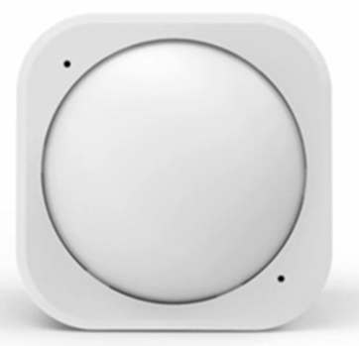
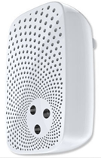
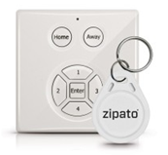
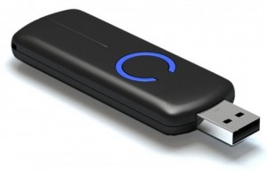
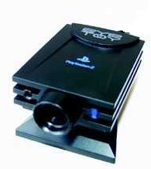
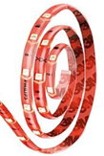
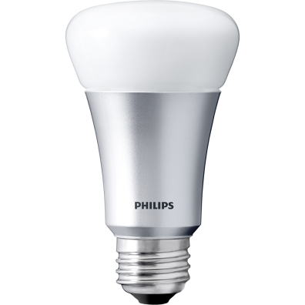
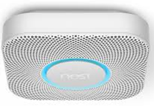
Used hardware
Philips Hue Bridge
Philips Hue Lamps / Strips
Z-Wave USB Dongle
Z-Wave Aeon Horn
Z-Wave Aeon IR detector
Z- Wave Keypad
Google Nest Protect
USB Webcam

Slide 5
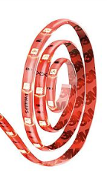

Hardware View – Configuration 1
Bulb
Light
Strip
Solar
Converter
Raspberry Pi
PlaatProtect
Sense Hat (Pi)
Zigbee
(mesh network)
Wifi
Wifi
Wifi Router
Ethernet
USB
Z Wave
(mesh network)
Ethernet
ADSL Router
USB
USB
Alarm
Push
Message
UTP
IR Detector(s)
Alarm
Horn
Internet
Webcam
1
Webcam
2
Keypad
with ID tags

Slide 6
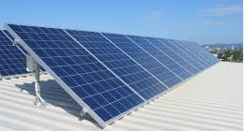
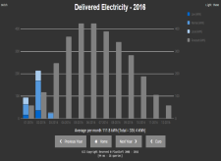
Hardware View – Configuration 2
P1 cable
Digital Energy
Meter
Bulb
Light
Strip
Bluetooth
USB
Digital Gas
Meter
Solar
Converter
Raspberry Pi
PlaatEnergy
PlaatProtect
Sense Hat (Pi)
Zigbee
(mesh network)
Wifi
Wifi
Wifi Router
Ethernet
USB
Z Wave
(mesh network)
Ethernet
ADSL Router
Alarm
Push
Message
USB
USB
UTP
IR Detector(s)
Internet
Alarm
Horn
Webcam
1
Webcam
2
Keypad
with ID tags

